Slide 1
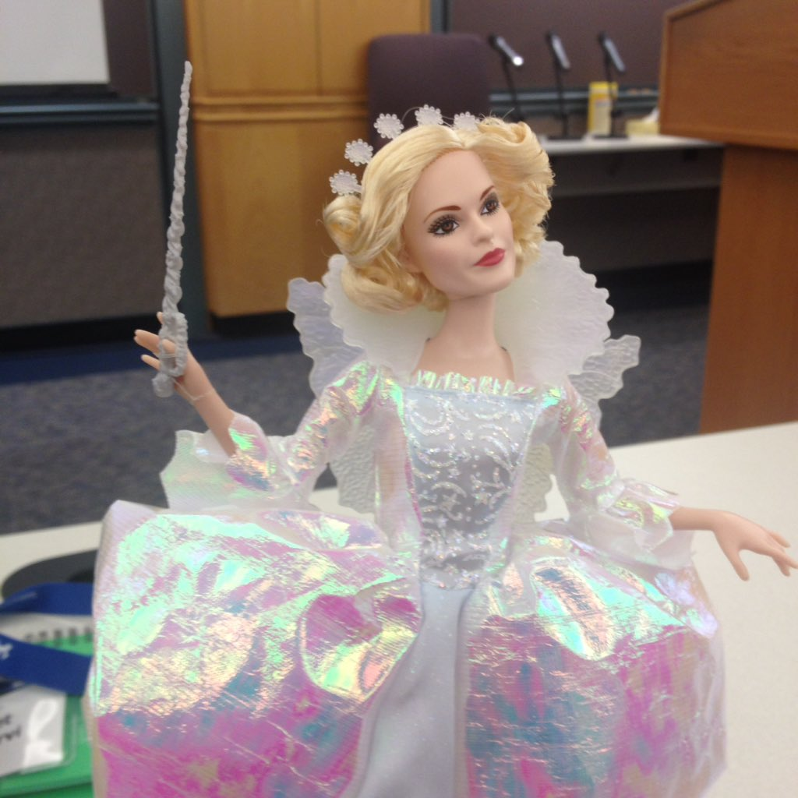

Exploratory Testing of Computer Interfaces
by Maaret Pyhäjärvi

Slide 2
https://github.com/maaretp/exploring-interfaces
Maaret Pyhäjärvi
Attribution (Finland)
http://creativecommons.org/licenses/by/1.0/fi/
http://creativecommons.org/licenses/by/1.0/fi/deed.en

Slide 3
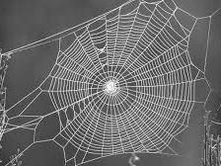
Exploratory testing is a systematic approach for discovering risks using rigorous analysis techniques coupled with testing heuristics.
- Elisabeth Hendrickson

Slide 4
Exploratory Testing: Frame of Management
Coaching
Debriefing
Perception of quality and coverage
Quality Report
Past
Results
Obstacles
Outlook
Feelings
”A day’s work”
Test Manager
Vision (“Sandbox”)
Current Charter
Metrics summary
Tester
Other Charters
Details
#
Session sheets of the past testing
?
Charter backlog of the future testing
x
#, ?, x, +
Next in importance!
20:20:60
Idea of exploration
Bug Reports
Playbooks
Coverage outlines
Out of budget

Slide 5
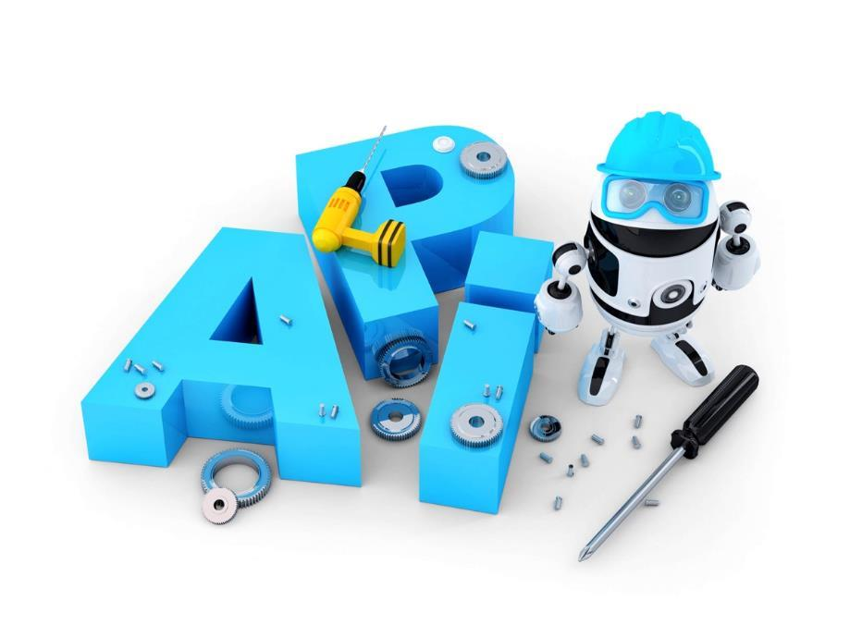
An application programming interface (API) is a set of routines, protocols, and tools for building software and applications.

Slide 6
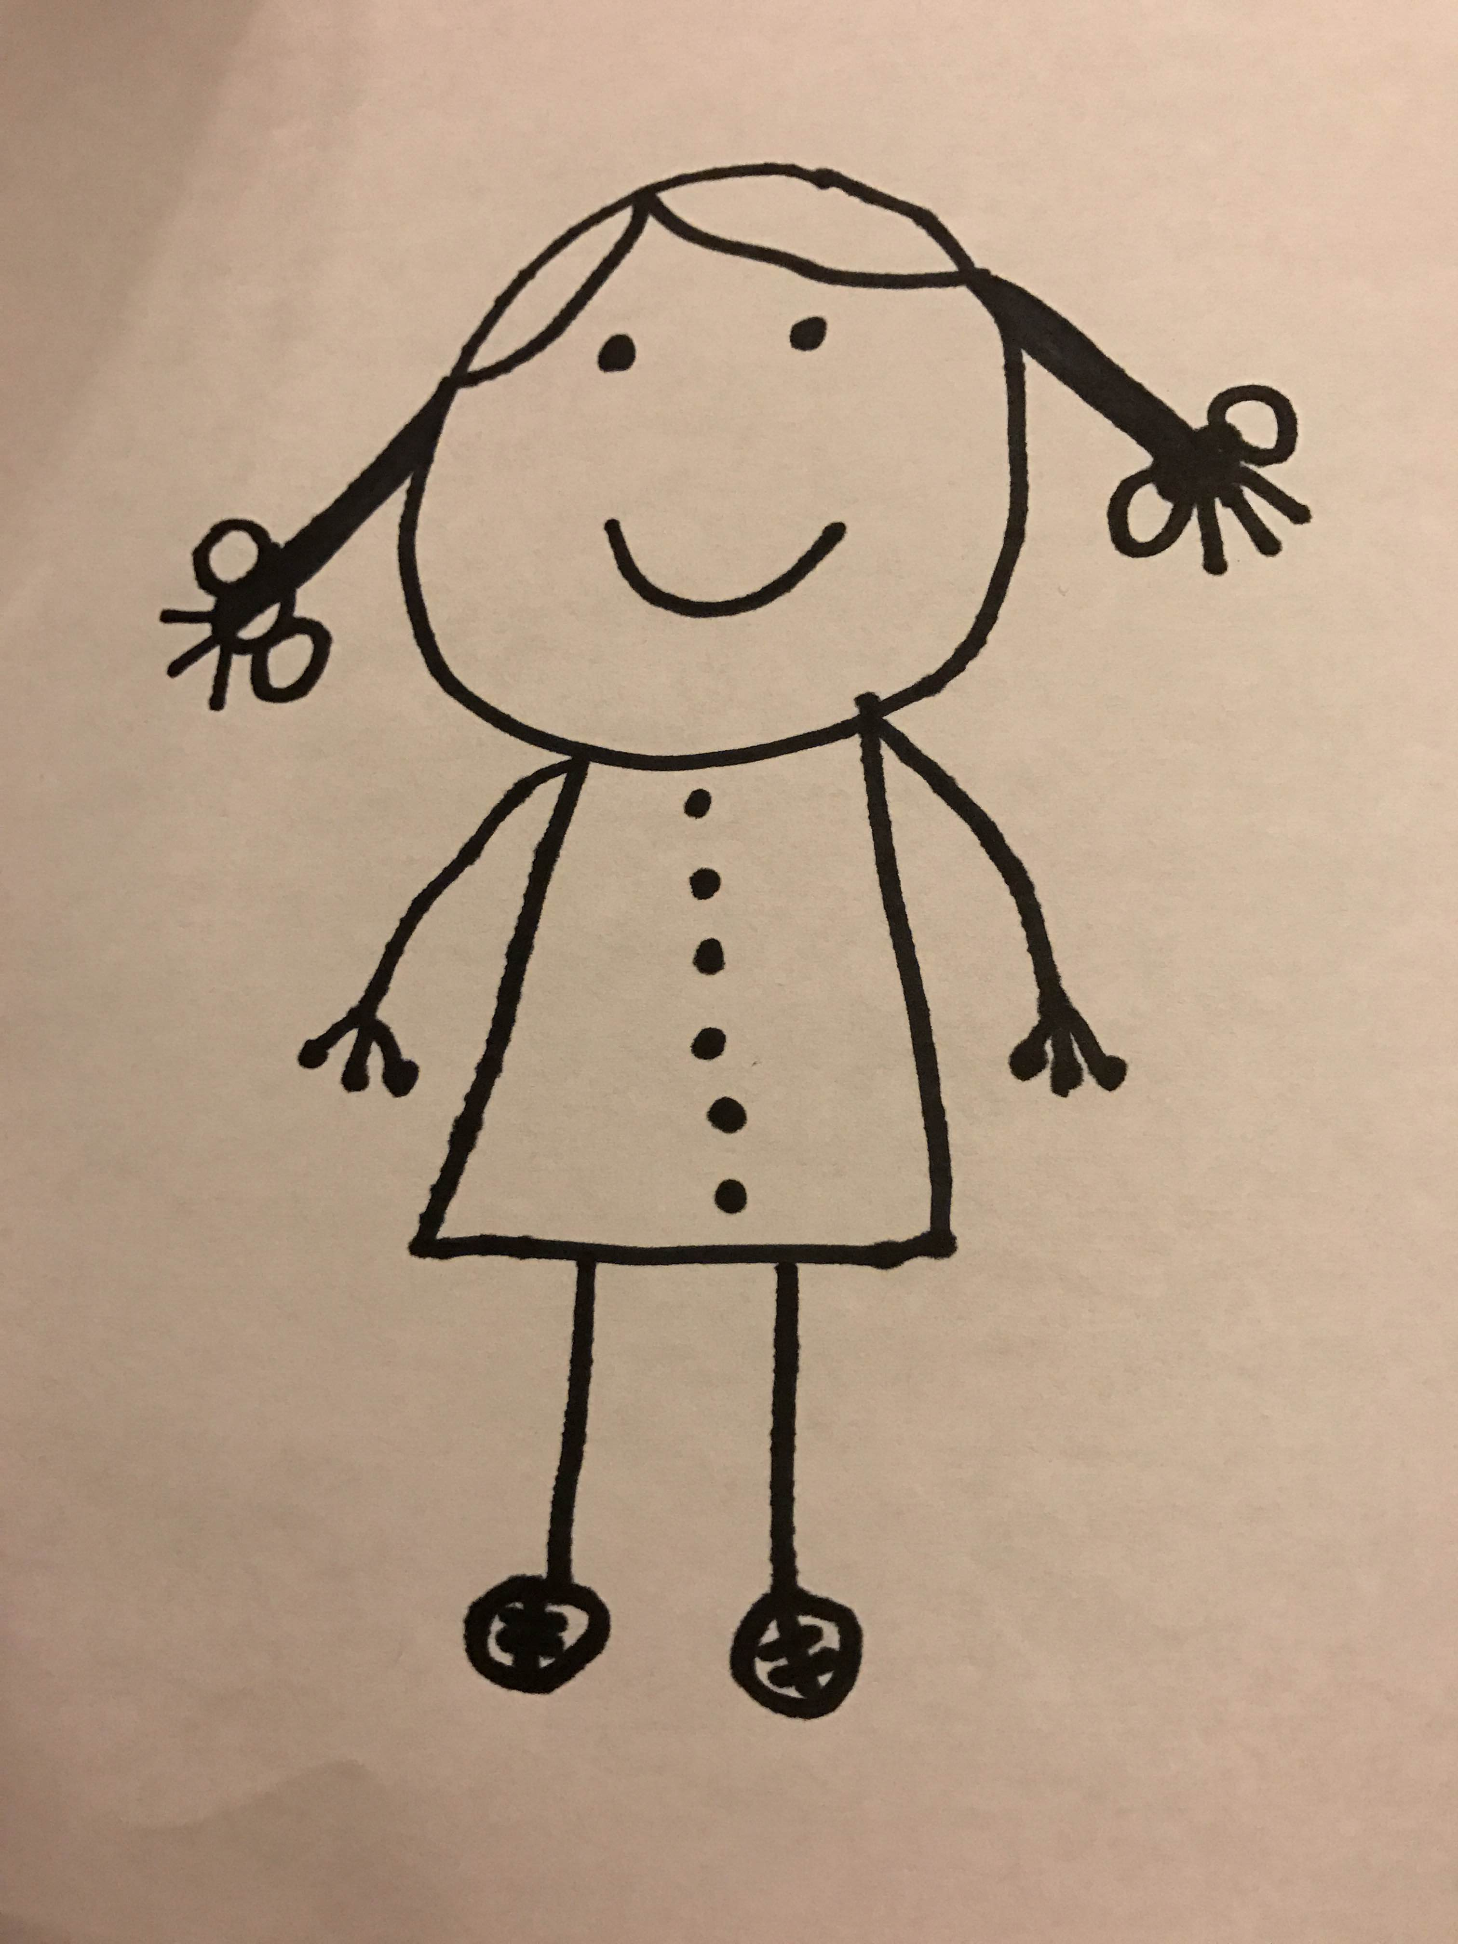
Product is my external imagination
(Exploratory) Tester

Slide 7
Strong-Style Navigation
“For an idea to go from your head to the computer it must go through someone else’s hands”
*http://llewellynfalco.blogspot.fi/2014/06/llewellyns-strong-style-pairing.html

Slide 8
Situation: You are in a real job interview for a QE/SQE/Tester position and they ask you following question. Do not use several minutes to think the answer, instead try to answer as you would answer in real interview situation (start answering in some 10-20 seconds).

Slide 9
How Would You Test a Text Field?

Slide 10
Junior tester or not a tester
Category definition: They know little or nothing about testing
Example answer types:
Would give less that 5 type of inputs: e.g. only characters, numbers and funny character like "%&$
Would assume that this is a unit test
Would test it Automatically (and nothing else is said)
Would talk about hardware requirements
Would separate test design and executions as own tasks and even to dedicated people
Would think this is really big task and requires several people to do it
Would think that text field is only for showing the text (not looking like field on screen)

Slide 11
Tester / QE with functional testing experience
Category definition: They can quickly list basic things that need to be covered, but stop there and They can follow given tasks and requirements, but don't really search for all the facts
Example answer types:
Lists 5 or more things from following testing ideas:
alphabetic + number; special characters; double-byte characters
fill up the field
try to copy/paste to and from the field
character limit
correct character's shown
erasing text
does text fit to the field
leave blank?
line change with Enter?
HTML
SQL
Lists 5 from above and then starts talking about processes (which this question was not about) like:
Returning things to developers
Entering bugs
Retesting after developer has fixed the bugs

Slide 12
Excellent functional tester / close to real senior QE
Category definition: They can come up with huge amount of different ideas that would need to be tested, and they realize that there isn't necessarily time to do it AND They at some point notice that they actually want to know what this text field is?
Example answer types:
Instead of just listing the things in above category also understands things like:
equivalence classes, boundary tests, positive and negative testing, fractions, ...
finding requirements and limitations
is there time/value/reason to test it more?
different testing levels (e.g. for unit testing they would need to see the code)
security testing (e.g. SQL injections, XSS, ...)
Very long answers (almost like a book) that covers everything (well good that you know that, but there is shorter and better answer there)
Answer includes talking to developers, product owners, customers, ...
In addition to one or more of the 3 above, they at some point noticed that they actually need to figure out what this text field is all about

Slide 13
The real senior QE
Category definition: They answer back with questions and they can question everything first: ideas, requirements, business needs, assumptions, …
Example answer types:
What is this text field about?
My first thought would be "With the information given - in no way". But as this wouldn't be a very polite answer, I would start asking for more information about the context

Slide 14
This_box Text Field

Slide 15
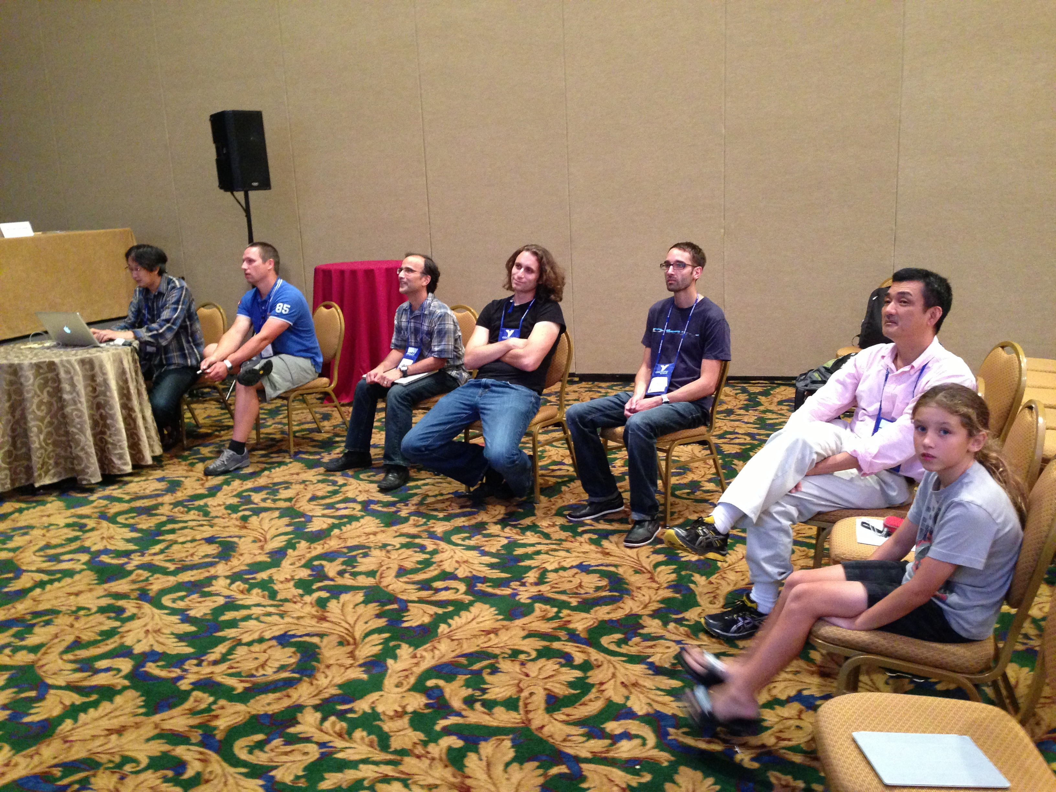
Lets Test!
"All the brilliant people working on the same thing, at the same time, in the same space, on the same computer." -- Woody Zuill

Slide 16
Gilded Rose
By Emily Bache (available in 32 languages…) https://github.com/emilybache/GildedRose-Refactoring-Kata

Slide 17
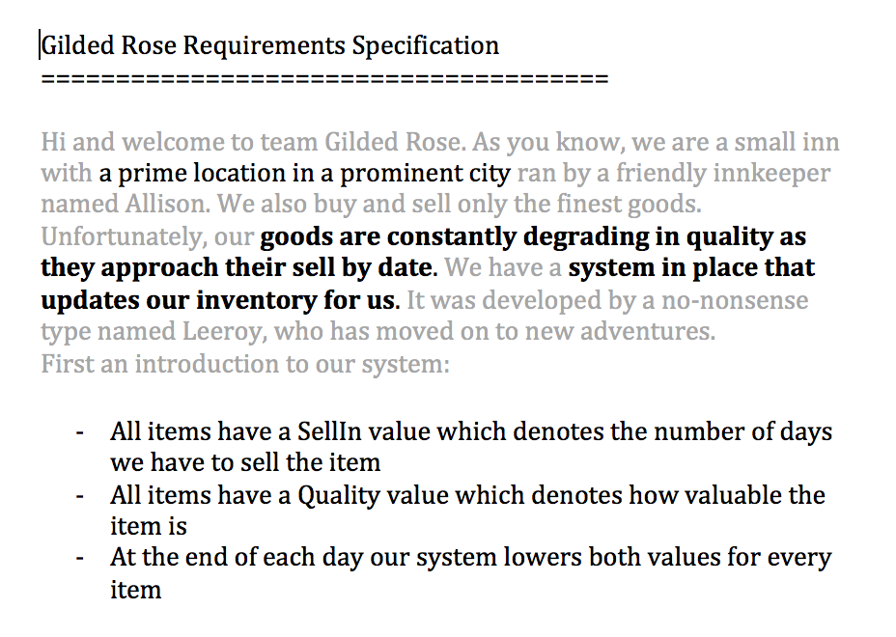

Slide 18
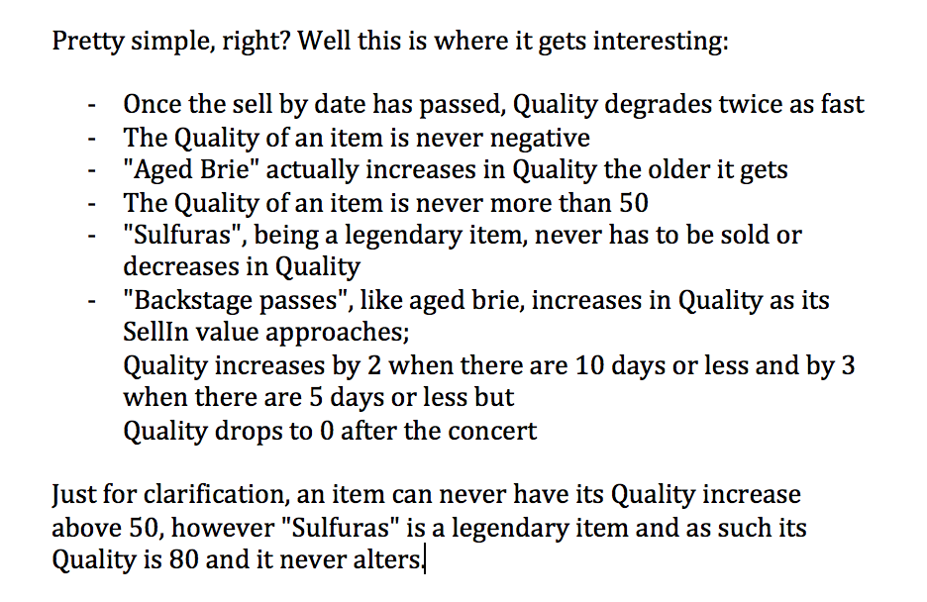

Slide 19
Disposable test automation
Test automation
as documentation
Notes:
Artifacts as discretionary output.

Slide 20
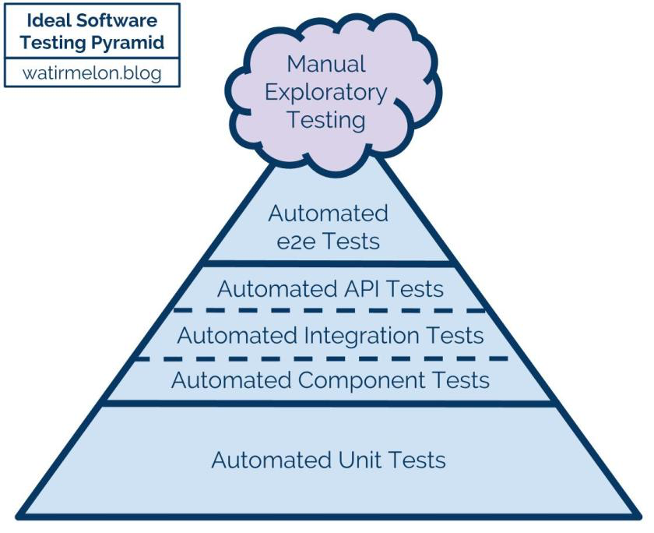

Slide 21
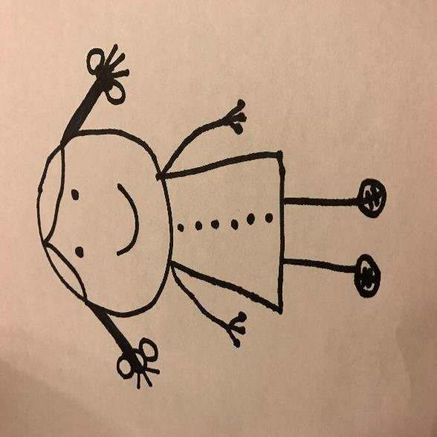
Exploratory Testing
Test Automation
Exploratory Tester
Notes:
Focus on the 1st (always first) test execution because there is no need to repeat!

Slide 22
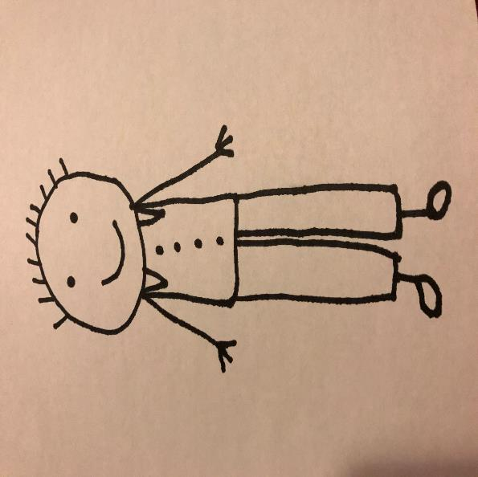
Test Automation
Exploratory Testing
Test Automation Specialist
Notes:
Focus on the repeating text execution as there’s not more to learn than what the script captured.

Slide 23
Focus on the 1st (always different) test execution because repeating narrows scope!
Focus on the repeating text execution to capture it. Repeating exactly is valuable!
Exploratory Tester
Test Automation Specialist

Slide 24
REST APIs
Libraries
Frameworks
Languages
Methods
CLI
Interfaces

Slide 25
DX
Developer Experience

Slide 26
Building it the First Time
Debugging and Maintaining

Slide 27
How to Explore
Do something with it
Find out what is the common thing to do with it
Find out what you could do with it
Reflect after anything and everything – make notes
What do we know from other connections?
What do we know from empirical evidence?
How do we turn it all into empirical evidence?

Slide 28
REST API

Slide 29
Verbs
Authorization/authentication
Data
Errors
Responsiveness
http://qa-matters.com/2016/07/30/vader-a-rest-api-test-heuristic/

Slide 30
Methods
HTTP GET - R
HTTP POST - CU
HTTP PUT - U
HTTP DELETE - D
HTTP PATCH - U
Status Codes
1xx: Informational
2xx: Success
3xx: Redirection
4xx: Client Error
5xx: Server Error

Slide 31
LIBRARY

Slide 32


Slide 33
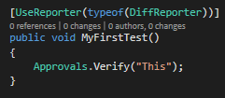

Slide 34
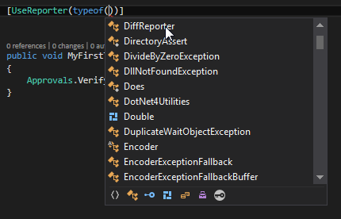

Slide 35
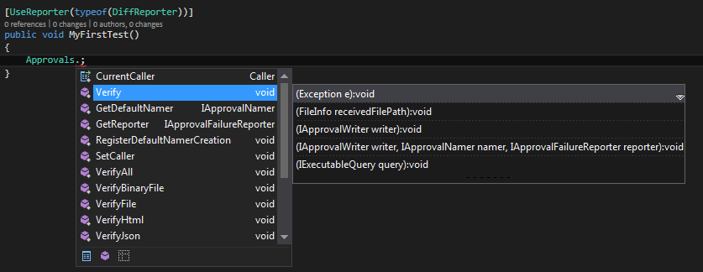

Slide 36
Structure Function Data Platform Operations Time
SFDPOT heuristics from James Bach / Michael Bolton, Rapid Software Testing

Slide 37
Approvers do
I LEARNED ABOUT FUNCTIONS
Formatting
Sorting
File Extensions
Scrubbing (removing common inconsistencies)
Serialization(saving to a file)
Mocking
Proxying
Rendering
Execution (e.g. retrieve the URL)
Aggregating test cases
File naming
PRINCIPLE: ”Every time you handle this type of object, you do these things to it.”

Slide 38
Reporters do
I LEARNED ABOUT FUNCTIONS
Waiting
Scrubbing (removing common inconsistencies)
Execution
Launching
Serialization
Decompilation
Chain of responsibility
Creating Approved file
Environmental awareness

Slide 39
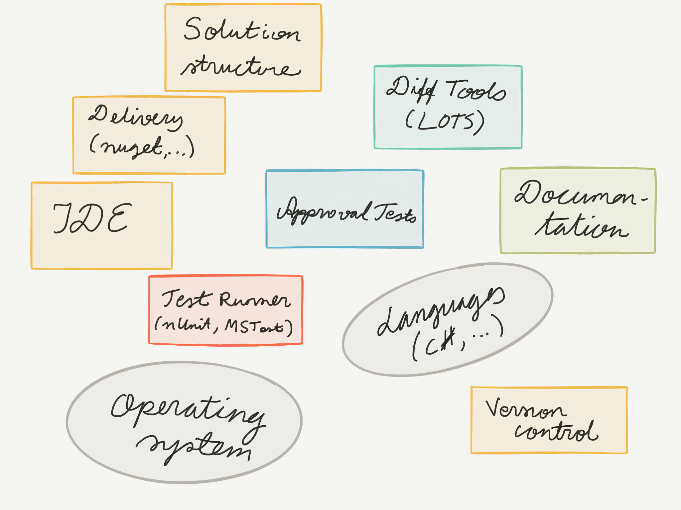
I LEARNED ABOUT THE ENVIRONMENT

Slide 40
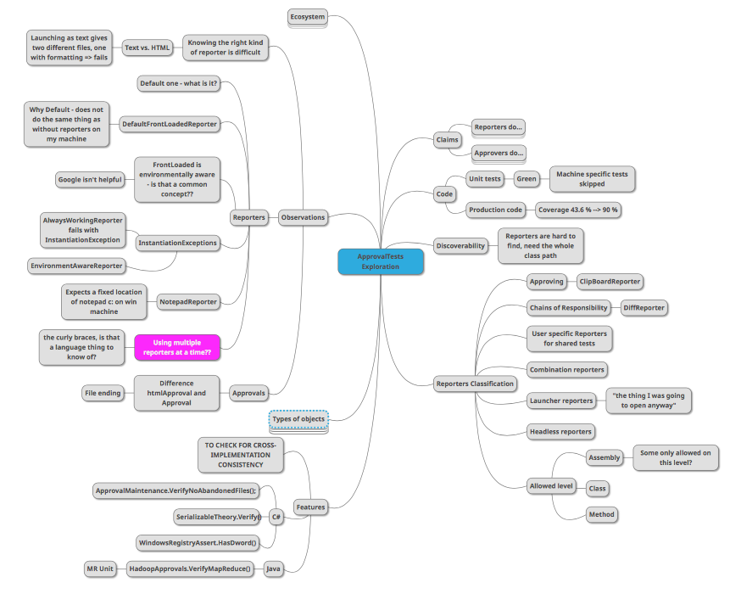

Slide 41
Approvers do
I LEARNED ABOUT FUNCTIONS
Formatting
Sorting
File Extensions
Scrubbing (removing common inconsistencies)
Serialization (saving to a file)
Mocking
Proxying
Rendering
Execution (e.g. retrieve the URL)
Aggregating test cases
File naming
PRINCIPLE: ”Every time you handle this type of object, you do these things to it.”

Slide 42
Reporters do
I LEARNED ABOUT FUNCTIONS
Waiting
Scrubbing (removing common inconsistencies)
Execution
Launching
Serialization
Decompilation
Chain of responsibility
Creating Approved file
Environmental awareness

Slide 43
I LEARNED ABOUT THE ENVIRONMENT

Slide 45
Patterns of Exploration for APIs
Lessons Distilled

Slide 46
Working with limited understanding: Focus!
Notes:
People freeze when facing the Unknown: non-programmers fear code; programmers fear languages they don’t work in; everyone fears unknown applications.

Slide 47
Calls and Operations. Inputs and Outputs.
Exceptions.
Notes:
Extending an API – Can you?
Find your building blocks.

Slide 48
Target of your testing vs. the environment it depends on

Slide 49
Specific user with a specific purpose
Notes:
Intended use. Misuse.

Slide 50
Why would anyone use this?

Slide 51
Think lifecycle Versioning and Deprecation

Slide 52
Google for Concepts like “Conservative Overloading Strategy”

Slide 53
Fast-track your understanding: collaborate

Slide 54
Documentation Matters a Lot for APIs
Notes:
Discoverability without automation
Copy-pasteable
Just the right amount
Available in the tooling where you use the API
Names should be meaningful. Programmers are people too!
Ordering of parameters. TDD to create nicest possible signatures that make sense in english!
Consistent with language. Type of tools. Helping people using it with the memory loading.

Slide 55
Explore to create documentation
Notes:
The developer support site with copy-pasteable examples
MTFHW (hello world) and MTFWA (working application)

Slide 56
Some patterns become visible with repetition
Notes:
Artifacts as discretionary output. Search "<ns1:Koodi>" (443 hits in 169 files) in VE
Y:\ELLU\LAPA\Testaus\Kokonaiseläketurvan-ote\Ansaintatiedot-VE\HaeAnsaintatiedot-VE__ 20110307 14-22-15.xml (4 hits)
Line 1313: <ns1:Koodi>YL130I</ns1:Koodi>
Line 1317: <ns1:Koodi>LAPA_172_011</ns1:Koodi>
Line 1321: <ns1:Koodi>67</ns1:Koodi>
Line 1324: <ns1:Koodi>67</ns1:Koodi>
A lot of text cut away from here…

Slide 57
Summing It Up For Exploratory Testing
Key Concepts

Slide 58
What Testing gives Us
Testing as performance
SPEC
FEEDBACK
REGRESSION
GRANULARITY
Test Automation
GUIDANCE
UNDERSTANDING
MODELS
SERENDIPITY
Exploratory Testing
Testing as artifact creation
Notes:
There’s a group of people who think of testing as creating artifacts: test cases, test automation. Tests are something that is used later for testing to happen again. The modern way of thinking leads this group of people to mostly consider test automation, recognizing that making people run mundane repeatable scripts isn’t the goal. With the automation artifacts, we get four types of benefits. The tests work as specification, giving us a detailed example of something. The tests give us feedback when we’ve implemented something, to see if what we have is what we intended. The tests stay around to guard us against regression, us forgetting details when paying attention elsewhere. And the tests give us granularity, helping us see where the problem is when the tests fail.
Another group of people thinks of testing as performance. It’s learning in layers, to prepare for the ultimate show with all the rehearsals where continuous learning enables us to put our best performance forward towards the end. Artifacts might be useful, but they are often more of an output to document all the layers of learning rather than driving the thinking. With testing as performance, we also get four types of benefits. While this style of testing does not give us a spec, it gives us guidance. It’s often not a binary Yes/No, but more of a consideration if there could be a problem here. The guidance enabling us to learn about the unknown unknowns turn into specs as we make our decisions on how to react to feedback. This testing gives us understanding, in the wider context of use and value. This testing gives us models of what the world around the application looks like, enabling us to go back to lessons we’ve learned and fast-track future learning. Finally, this testing gives us serendipity, lucky accidents to find many of the things that we should know of, but turn blind to assuming we know what we’re looking for.
While exploratory testing starts with the testing as performance in mind, it also generates artifacts whenever deemed useful. Testing of an API is a great way to get to the core of this difference in how we think about testing.
All testing may be exploratory, but some of it is focused on creating artifacts. Saying “scripting is just an approach” is belittling when scripting can be the main approach to use the powers when testing.
“there’s a process of knowing” – learning
Does not give as regression; serendipity (safety against things happening randomly) / unwanted serendipity events.
This is what it is and what it could be. There’s a direction to it, not just statement of what it is.
Coaching is not just feedback, it’s pointing them to the right way.
Safety.
EXPERIENCE (the verb) rather than facts ; emotions over facts. REACTIONS.
HISTORY, Lessons learned, checklists. Modeling.
UNDERSTANDING – where you start (knowing the thing (code & environment), knowing the user, knowing the problems, knowing the developers (how to help them and what they do so that you can efficiently test), knowing the hackers (weird use cases outside common ‘have you tried reading it upside down’) , knowing all stakeholders, knowing the business priorities)
Uncovering things I cannot know, giving the application a change to reveal information for me.
This allows you to know things.

Slide 59
Testing is Everywhere!
Before implementing
While implementing
Before production
While in production
Testing as artifact creation
Testing as performance (exploration)
TOTALS
Ways to think of testing peak at different moments with regards to adding a capability

Slide 60
Exploratory Testing: Frame of Management
Coaching
Debriefing
Perception of quality and coverage
Quality Report
Past
Results
Obstacles
Outlook
Feelings
”A day’s work”
Test Manager
Vision (“Sandbox”)
Current Charter
Metrics summary
Tester
Other Charters
Details
#
Session sheets of the past testing
?
Charter backlog of the future testing
x
#, ?, x, +
Next in importance!
20:20:60
Idea of exploration
Bug Reports
Playbooks
Coverage outlines
Out of budget

Slide 61
Exploration Skills Source: Adapted from James Bach, Jon Bach, Michael Bolton. Exploratory Testing Dynamics. v.2.2. 2009
Self-management
Developing ideas
Examining product
Done
To Do
Issues
Coverage
All sources available
Best use of time – effective and efficient work
Making models
Tool support – creative solutions
Risk-based testing – scientific approach
Keeping one’s eyes open

Slide 62
1.00^365 = 1.00
1.01^365 = 37.8

Slide 63
Experts are not the one ones who know the most but ones who learn the fastest

Slide 64

Maaret Pyhäjärvi
Email: maaret@iki.fi
Twitter: @maaretp Web: maaretp.com
Blog: visible-quality.blogspot.fi
(please connect with me through Twitter or LinkedIn)

